Slide 1

#Raho Ambitious
Named Entity Recognition
Instructor: Murtuza Dahodwala
Senior Data Scientist | Data Science Mentor

Slide 2



Course : Machine Learning
Lecture On : Named Entity Recognition
Instructor : Murtuza Dahodwala

Slide 3

Agenda
What is NER?
Why we need it?
How does it works?
Open Source NER
Advantages of using SpaCy
Understanding SpaCy
Recap of Parsing
Code Walkthrough
Q n A

Slide 4
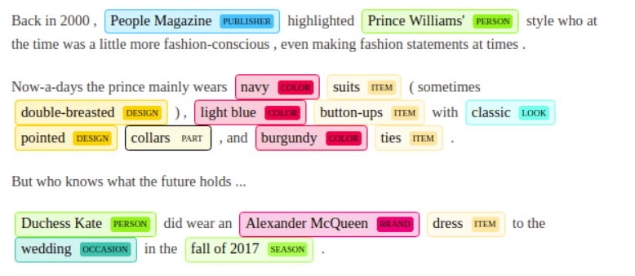
What is NER?
Named entity recognition is a natural language processing (NLP) technique that automatically identifies named entities in a text and classifies them into predefined categories.
Entities can be names of people, organizations, locations, times, quantities, monetary values, percentages, and more.

Slide 5

Why we need it?
We need NER for information extraction and to understand the context of a sentence.
Some of the popular use cases of NER are:
1) Chatbot
2) Content classification and Recommendation
3) Research Papers
4) Search Engine
5) Automatic reviewing of resume

Slide 6
How does it works?
As a human it is easy for us to recognize named entities like people, values, locations, and so on.
For example, in the sentence “Sundar Pichai is CEO of Google located in USA”
We can easily identify four types of entities:
“Person”: Sundar Pichai
“Designation” : CEO
“Organisation” : Google
“Country”: USA
But for computers we need to help them recognize entities first so that they can categorize them.
This is done through machine learning and Natural Language Processing (NLP).

Slide 7
How does it works?
NLP is used to read, decipher, understand, and make sense of the human languages in a manner that is valuable, while machine learning helps machines to learn and improve over time.
Hence we need to teach NER model which words are entities in a text and also to which category they belongs to.
So first, we need to create entity categories, like Name, Location, Event, Organization, etc or anything which suits your domain or use case and feed an NER model relevant training data. Then, by tagging some word and phrase samples with their corresponding entities, you’ll eventually teach your NER model how to detect and classify entities by itself.

Slide 8

Open Source for Python
Top 3 Open Source NER libraries are:
Stanford Named Entity Recognition (Implementation in JAVA but NLTK provides wrapper to use SNER in python)
NLTK (ne_chunk)
SpaCy
NLTK was created to support education and help students explore ideas.
While SpaCy is the most preferred library by app developers for NLP.

Slide 9
Advantages of SpaCy
SpaCy is preferred for Advanced Natural Language Processing in Python as it allows training with deep learning algorithms.
We can use more than 60 languages available for text processing such as English, Hindi, Spanish, German, French, Dutch. Mainly focus on industrial purpose.
It is designed specifically for production use and helps build applications that can process and understand large volumes of text.
It provides a default model which can recognize a wide range of named entities, which include person, organization, language, event etc.
SpaCy also gives us the liberty to add classes to the NER model, by training the model to update it with newer trained examples.

Slide 10
Understanding SpaCy
SpaCy divides itself into two parts:
spaCy’s Statistical Models
spaCy’s Processing Pipeline
spaCy’s Statistical Models
These models are the power engines of spaCy. These models enable spaCy to perform several NLP related tasks, such as part-of-speech tagging, named entity recognition, and dependency parsing.
Importing these models is super easy. We can import a model by just executing spacy.load(‘model_name’)

Slide 11
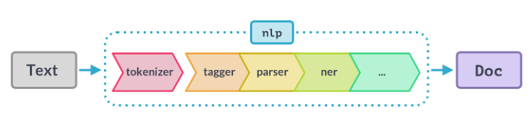
Understanding SpaCy
spaCy’s Processing Pipeline
The first step for a text string, when working with spaCy, is to pass it to an NLP object. This object is essentially a pipeline of several text pre-processing operations through which the input text string has to go through.
From above figure we can see that , the NLP pipeline has multiple components, such as tokenizer, tagger, parser, ner, etc. So, the input text string has to go through all these components before we can work on it.

Slide 12
Parsing Recap
Two Types
Constituency Parsing: Identifying the constituents in a sentence and relations between them. This helps understand the syntactic nature of the sentence and its meaning.
Dependency Parsing: as the name suggests, aims at uncovering the dependencies between individual lexical items (words) and does not depend on the order of these items
What about thisupGrad is a great platform !
A group of words that functions together as a single unit -- a constituent

Slide 13
Constituency Parsing
CP forms the basis of many advanced NLP tasks
Since it helps in understanding the overall meaning of a sentence, frequently used in Word Processing software such as MS Word, Open Office for Grammar checking
Used as a component in Question Answering systems to understand the meaning of user questions

Slide 14
Constituency Parsing
We saw Statue of Liberty flying over New York.
We saw Statue of Liberty flying over New York.
We saw Statue of Liberty flying over New York.
NP
VP
NP
VP

Slide 15
Dependency Parsing
Dependency parsing, as the name suggests, aims at uncovering the dependencies between individual lexical items (words) and does not depend on the order of these items.
Unlike Constituency parsing, Dependency paring does not describe the overall structure of the sentence
It only identify relations (dependencies) between individual words in a sentence and produces a concise representation of these dependencies

Slide 16
Dependency Parsing
upGrad is a great platform.
upGrad is a great platform .
NNP
VBZ
DT
JJ
NN
.
amod
punct
det
cop
nsubj

Slide 17
Comparison
Constituents and Constituency Parsing:
Helps understand the meaning of sentences
Ambiguity; more than one CP tree for a given sentence
Dependency Parsing:
Dependency between individual word pairs in a sentence
More concise representation of sentence
Not as visually interpretable as CP trees

Slide 18

Let’s see the code walkthrough now !

Slide 19
Thank You !

